Slide 1

E-Commerce Store Sales Investigation
By Similoluwa Salako
Upright Education Data Analytics Bootcamp

Slide 2

Summary
The company being assessed is an E-Commerce store selling products in a variety of categories
Electronics, Sports, Toys, Home Décor, and Fashion
This E-Commerce store has customers that fall into different categories
Regular, Occasional, and Premium
The sales data being analyzed dates from 2023-2025

Slide 3

Business Problem
The key business problem to be solved is regarding profit.
We need to know what factors of the sales equation impact profit most and whether we can accurately predict profit based on the features of the sales equation.
In addition, we would like to know the best-selling product category and the customer segment with the highest profitability.
The features of the sales formula are: Price, Discount, Marketing Spend, and Units Sold

Slide 4

Data Preprocessing
The data for this analysis was procured from Kaggle
https://www.kaggle.com/datasets/nevildhinoja/e-commerce-sales-prediction-dataset
In total, there were 1000 rows of data
The data was relatively clean from the start, however, a few columns (Profit, Year, Month) were added to aid in the analysis.
Initial analysis was done in Microsoft Excel utilizing Pivot Tables and graphs. Some additional work was also done in Microsoft BI.
Further analysis was conducted in Python, mainly for data visualizations as well as for linear regression analysis
SQL was used to aggregate data and provide insights into the nature of the data.

Slide 5
Product Category Data

Slide 6
Fashion and Toys had the highest average discount amongst the product categories
Home Décor had the lowest average discount
All of the discounts are averaged within a few dollars of each other showing that no product category is specifically targeted for discounted pricing

Slide 7
Electronics was the best-selling product category, totaling over 6200 units
Sports was the second best-selling category
Fashion and Home Décor were the poorest selling categories. This could be due to low popularity amongst the target market

Slide 8
Sports is the highest priced product category, followed by fashion
Electronics are the cheapest product category

Slide 9
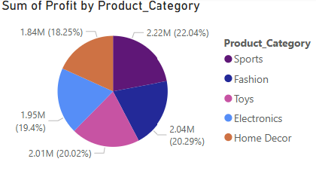
Sports was the most profitable product category
Sports was not the highest selling category meaning that its profitability is likely tied to pricing
Fashion was the second-best-selling category even though it sold the 4th most units per category
Home Décor was the least profitable, it was also amongst the poorer sellers in terms of units sold
Electronics was the best-selling product category but not the most profitable. This is due to its low average price.

Slide 10
Marketing Spend Data

Slide 11
The product category with the highest marketing cost was Electronics. Electronics was also the product category with the highest number of units sold
Home Décor and Fashion had the lowest marketing spend.
The low marketing spend may be due to the categories’ low profitability, or the low profitability may be due to lack of product visibility on account of the low marketing spend

Slide 12
The customer segment with the greatest marketing spend was Regular customers
It is likely that the store favors its repeat customers due to recurring business and thus spends more money trying to retain them
Premium customers was the customer segment with the lowest marketing spend
This could be because Premium customers buy with less frequency and thus the store does not allocate much marketing to their segment

Slide 13
The average marketing spend was highest for Regular customers
The store’s strategy could be to market to regular customers to keep them coming back
The least average marketing spend was for Premium customers, indicating that Premium customers may not be a priority for the store.

Slide 14
Customer Segment Data

Slide 15
The customer segment with the highest count is Regular customers, totaling roughly 345 individuals
Premium customers are the customer segment with the lowest count

Slide 16
Regular customers received the highest average discount amongst the customer segments
This could be part of a strategy to ensure that regular customers keep on returning to buy the store’s products
Premium customers received the lowest average discount
This again indicates that Premium customers may not be the store’s greatest priority

Slide 17
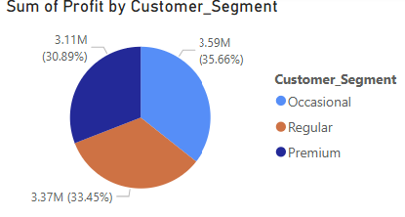
Occasional customers were the most profitable customer segment with profits totaling roughly $3.59 million
Although Regular customers were the customer segment with the highest number of individuals, it was not the most profitable
Premium customers were the least profitable customer segment

Slide 18
Sales Trends

Slide 19
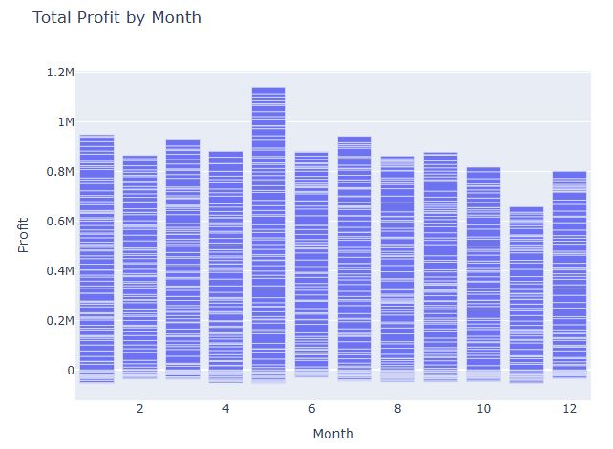
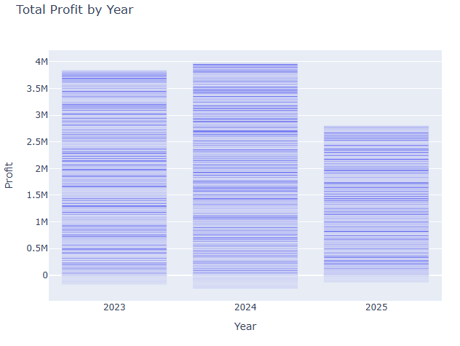
Sales Trends Over Time
The month of May was the most profitable for the store, followed by January and July
Sales were most poor in November
The most profitable month was 2024.

Slide 20
Regression Analysis

Slide 21
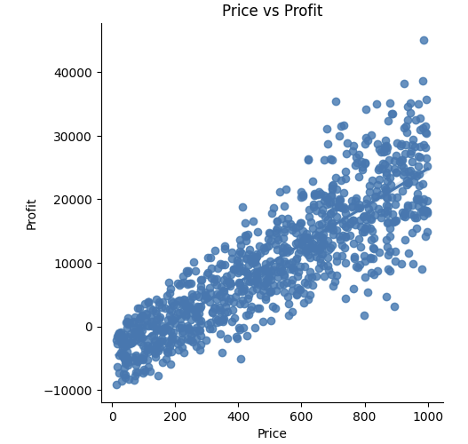
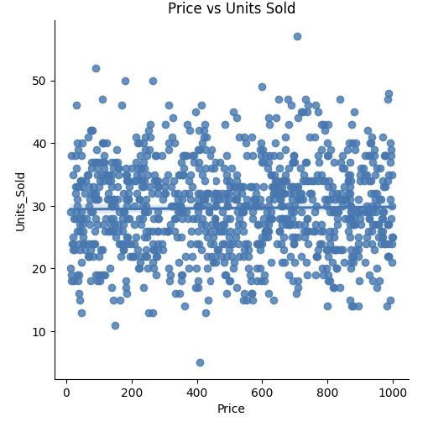
From the regression analysis, we can see that price is highly correlated with profit, as we increase the price, we see increased profits.
The analysis also shows that price does not have any correlation with units sold
This could mean that customers are not sensitive to pricing changes

Slide 22
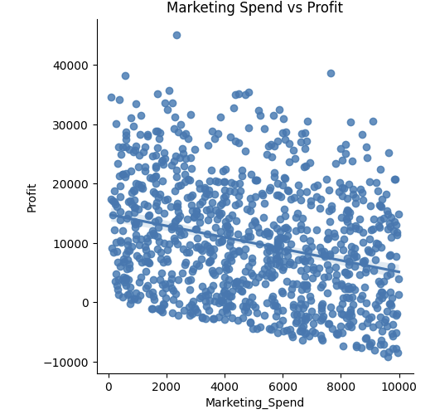
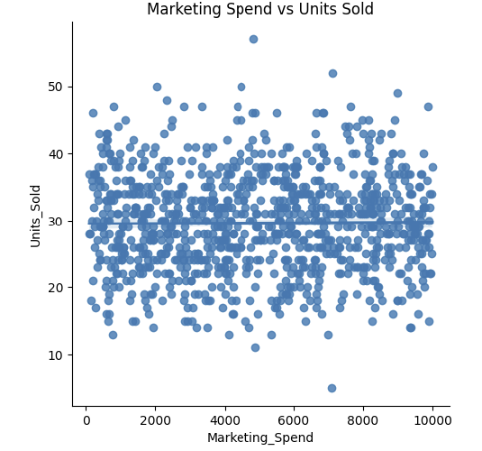
Marketing Spend is slightly negatively correlated with price, in that as we increase marketing spend, profits slightly decrease, but not by a large magnitude.
Marketing Spend is a cost, so it is likely that it is having a negative effect on the sales equation
Marketing Spend had no correlation with the amount of units sold
This may indicate that marketing the store’s products is relatively ineffective

Slide 23
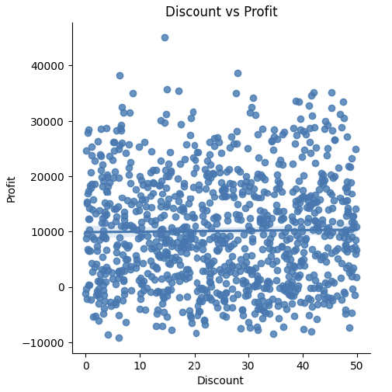
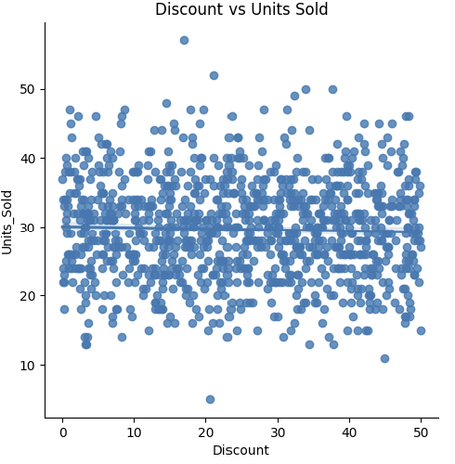
Discounting has almost no correlation with profits, showing that the amount the product is discounted does not greatly impact the amount of product sold.
Further analysis shows that Discounting does not have any correlation with Units Sold.
This analysis calls into question whether the practice of discounting should continue.

Slide 24
Recommendations
Pricing has the greatest effect on profit, so it may benefit the store to pay attention to its pricing strategy, possibly increasing the price of some items (e.g. Electronics).
Occasional customers were the most profitable segment, but it received only the second-highest amount of marketing spend. The store may see more profits if it focuses on the occasional customer segment with some kind of campaign.
Most of the store’s customers are Regular customers, indicating that they make recurring purchases. To reward this buying behavior, the store could implement a rewards program, offering free items or discounted items after making a specified number of purchases or after spending a certain amount.
Premium customers are not marketed to at the same level as Regular and Occasional customers, to better take advantage of the Premium customer segment, more marketing can be targeted towards them.

Slide 25
Next Steps
The store should rethink its discount campaign as it hasn’t been shown to affect Units sold or Profit.
An assessment of the pricing strategy should be undertaken, as price had the greatest relationship to profit.

